Slide 1
Title: HOUSING PRICE -PROJECT
Submitted by
ANJANA.P

Slide 2
Contents
Problem statement
Data Review
Data Cleaning
Problem Solving
Visualizations
Conclusion
References

Slide 3
PROBLEM STATEMENT
A US based housing company named surprise housing uses data analytics to purchase houses at low price and flip them at higher price
Project is based on reality basis
Company collected dataset from sale of houses in Australia
We have to predict the actual value of the properties and decide whether to invest on them or not.
Model must be a good way for the management to understand the pricing dynamics of new market

Slide 4
DATA REVIEW
Data contains 1460 rows and 81 columns
Output column is Sale price and it is linear values
There are presence of null values
Data has both numerical and categorical values
There are presence of outliers

Slide 5
DATA CLEANING
Tran test csv’s are concatinated and a new source column is added
All categorical datas are converted to numerical
Null values are checked
Multicollinearity is checked using heat map and correlation matrix
Skewness is checked
Presence of outliers are also checked using boxplot method

Slide 6
PROBLEM SOLVING
Anew source column is added to the concatenated csv file to know train and test data
Unwanted columns like id,and columns that provide no information for our analysis are dropped
Object datatypes are converted to integer using label encoder
Null values are treated using simple imputer function
Skewness is resolved using yeo-johnson method
Outliers detected using Zscore value and filled with median of each column

Slide 7
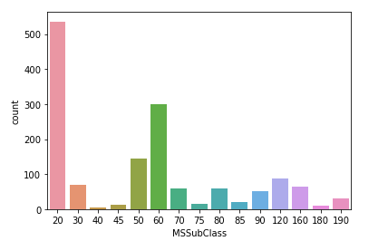
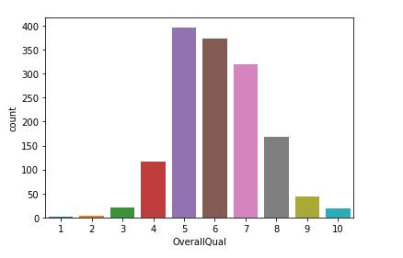
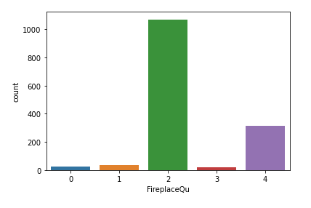
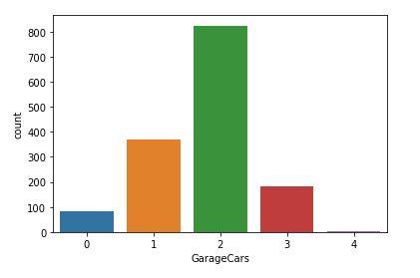
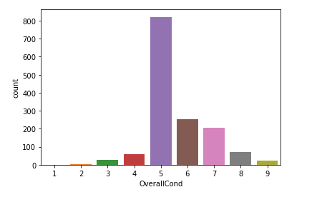
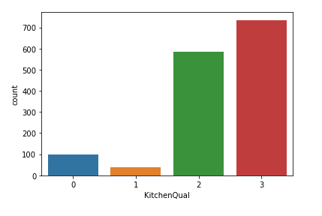
VISUALIZATIONS

Slide 8
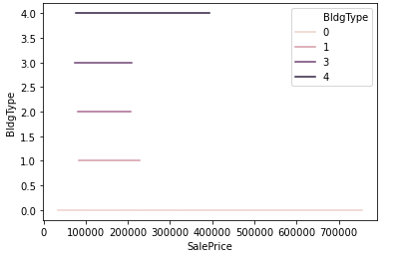
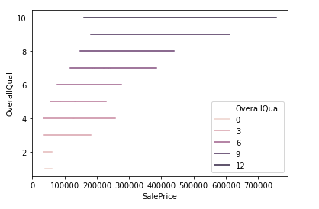
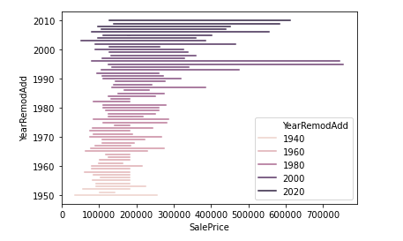
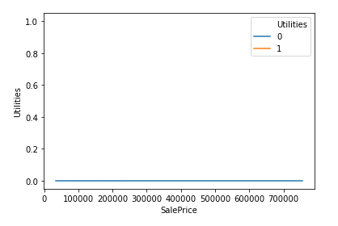
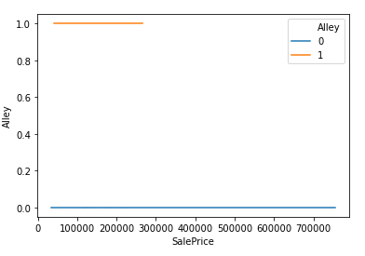
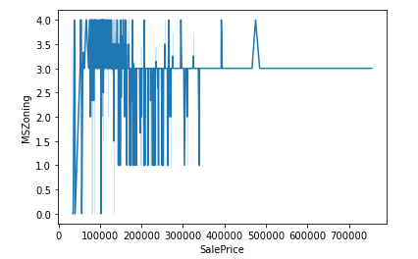
BIVARIATE ANALYSIS

Slide 9
MODEL TESTING WITH R2- SCORE
Linear regression-0.681
Decision tree regressor-0.409
Kneighbors regressor-0.645
SVR-4.24
Lasso-0.681
Ridge-0.681
Elastic net-0.687
Random forest regressor-0.707
Ada boost regressor-0.641

Slide 10
CONCLUSION
Sale price depends directly on kitchen area,basement area,garage area,car parking capacity ,no.of rooms etc..
Sale price doesnot depend much on kitchen quality,overall quality,fire place quality ,year built etc..
This means that customers mainly look for the space and comfortness for their future use and can renovate as per their wish ,if the house is spacious.
Demand is high for two family houses,town area ,good street ,good road access etc.
They may be planning to resell the houses,or give them for rent or other uses otherthan personel.That may be the reason they don’t focus on quality of material and finish.
Thus we can earn more profit in future if we concentrate more on town area and a good society with spacious houses,and also good road access and availability of emergency services .

Slide 11
REFERENCES
https://cxl.com/blog/outliers/
https://www.google.com/search?q=multicollinearity+in+regression&oq=muticollinearity&aqs=chrome.2.69i57j0i10i433j0i10l6.7595j0j7&sourceid=chrome&ie=UTF-8
https://www.google.com/search?sxsrf=ALeKk02HmEy5i9YItlkcqpojW8oOavLcIg%3A1613537096613&ei=SJ8sYJD3JKyc4-EPkJS4oAI&q=yeo+johnson+transformation&oq=YEO&gs_lcp=Cgdnd3Mtd2l6EAEYATIECCMQJzIFCAAQkQIyBwgAELEDEEMyCgguELEDEIMBEEMyBwguELEDEEMyBAgAEEMyBwguELEDEEMyBwguELEDEEMyBQguELEDMgUIABCxAzoICAAQsQMQgwE6AggAULabT1ibpE9gsMFPaABwAngAgAGXAogB-AWSAQUwLjMuMZgBAKABAaoBB2d3cy13aXrAAQE&sclient=gws-wiz

